Slide 1
Sallary gap predictionProject Status
Dor Bank, Shiran Mazor
Eylon Saadon

Slide 2
Business Goal
With economical and cultural advances world wide, we see that the wage and class differences between genders, are still substantial. In this project we will try to predict the wage difference, focusing on the OECD countries. Our product will be a prediction for each state in the OECD for years to come.
Main Focuse– the value we want to predict is defined as the difference between median earnings of men and women relative to median earnings of men. (base on the existing data from the OECD).
Data refer to full-time employees and to self-employed.

Slide 3
Dataset segements
Our preliminary data is:
World data bank – GenderStat.csv
http://data.worldbank.org/data-catalog/gender-statistics
The Gender Statistics database is a comprehensive source for the latest sex-disaggregated data and gender statistics covering demography, education, health, access to economic opportunities, public life and decision-making, and agency
The features statistics are arranged by years columns for each country
OECD data center – Gender wage gaps (csv)
The OECD data will be used as the predicted data, and we will try to build a model relying on the data from the world data bank.
Exploration for new data sets will occur after model evaluation if necessary.
OECD value meaning – the gender wage gap is unadjusted and defined as the difference between male and female median wages divided by the male median wages
At first, we will try to extract features solely from this data.

Slide 4
machine-learning problem product
Currently:
Input: vector consisting year, country and selected features
Output: gap prediction between the median sallaries
Optional:
Input: matrix for all 35 countries and a specified year
Output: averaged sallery gap.
reduced variance assuming unbiased estimate

Slide 5
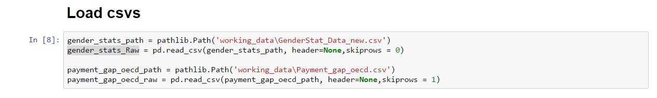
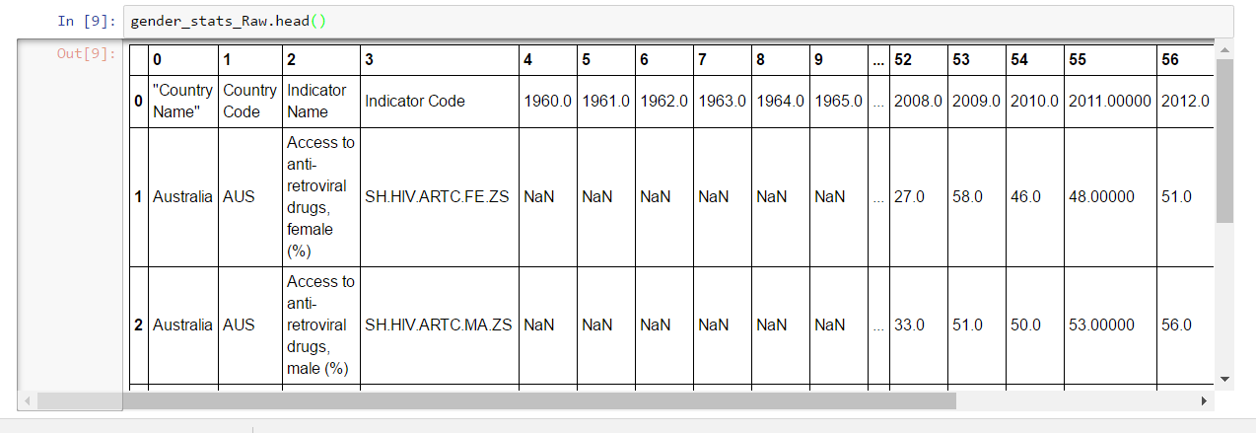
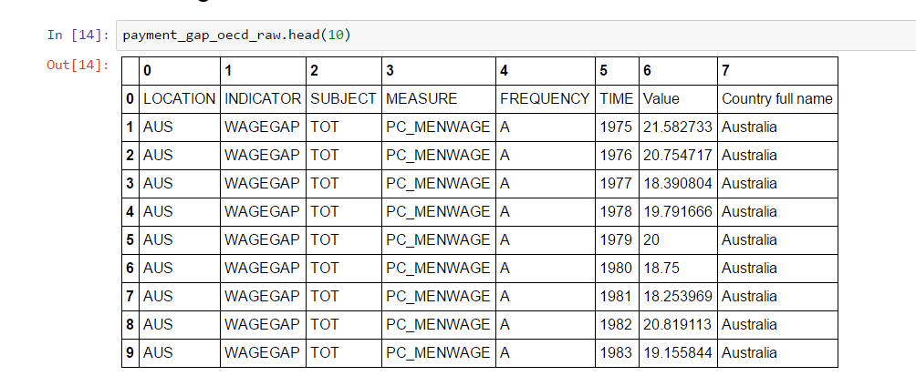
Dataset segements (2)

Slide 6
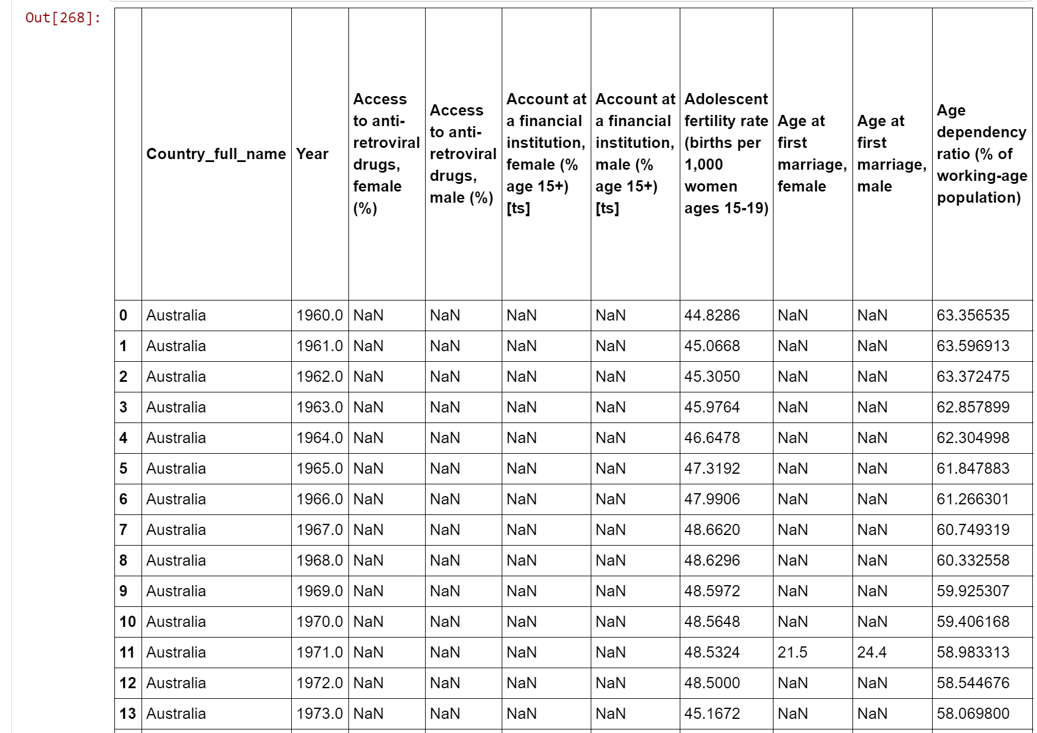
Data Preparation 2
Current GenderStat.csv after preliminary normalization -Transpose lines to columns
years, country , and indicator are now columns

Slide 7
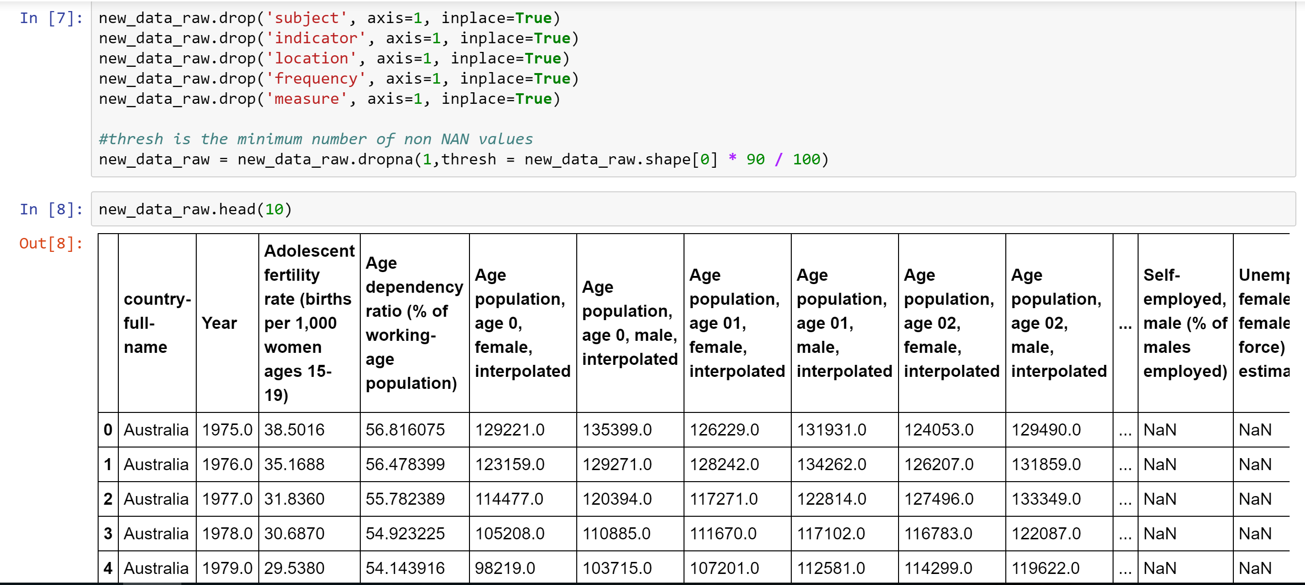
Data Preparation
Gender Stats CSV:
Travers GenderStats rows to columns.
OECD Wage gap CSV:
Add headers
Remove duplicate rows for the same year (Total and self employed in the same year for some countries)
Merge the two CSV’s on Year and Country
Remove unnecessary columns.
Null Values - Remove all rows with a certain percentage of null data:
We examined several thresholds and chose to go with 0.9.
Specified Data Types
Convert countries columns to binary indicators (treated as integers – {0,1})
All other features are float.

Slide 8
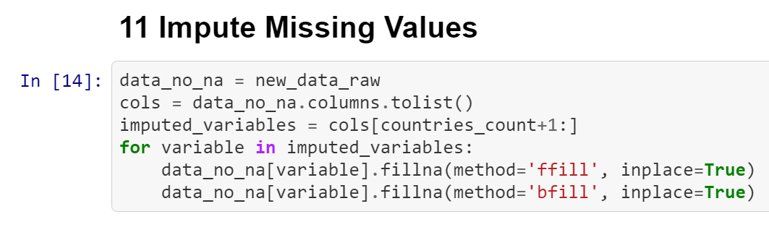
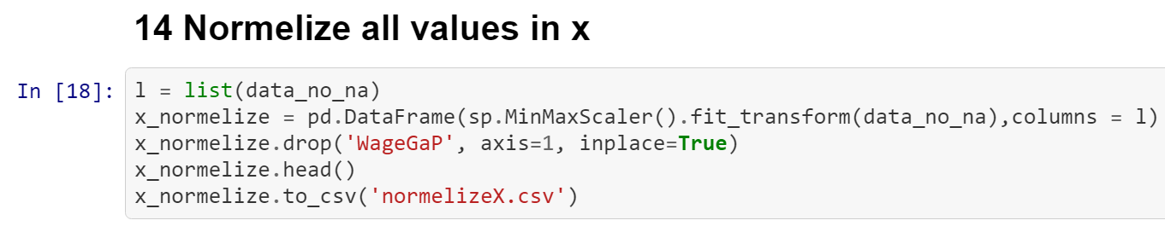
Data Preparation (2)
Fill Missing data
We examined a few methods to fill the missing data for some features on some years.
Perform forward fill – copy the last non null value.
Perform backward fill – copy the next non null values.
Normalize values
Convert all values except the wageGap to be
in range [0,1]

Slide 9
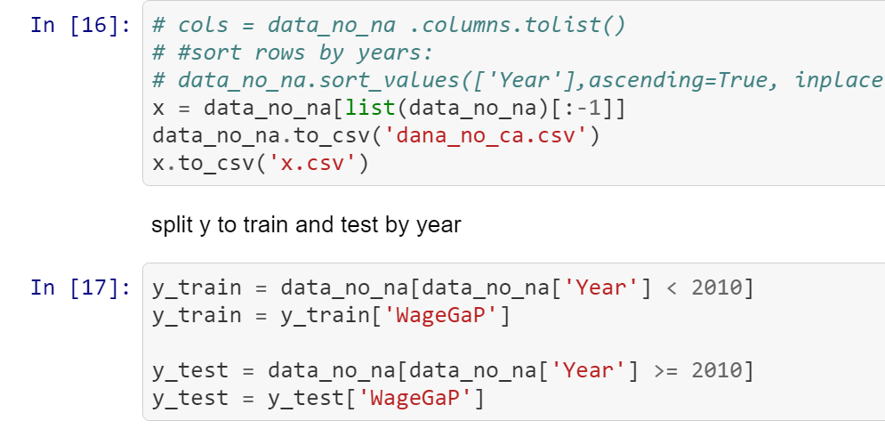
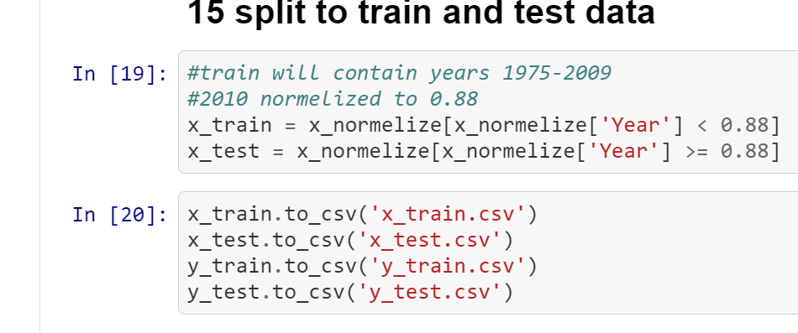
Train and test data
Train data - contains all features before 2010.
Test data – contains all features data between the years 2010-2016.
Split data to x and y matrix, y include only the wageGap column.

Slide 10
Data Modeling

Slide 11
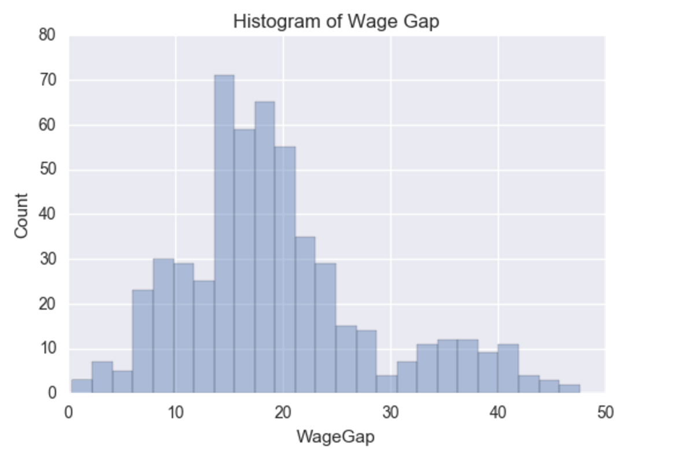
Data Statistics
Histogram of Wage Gap

Slide 12
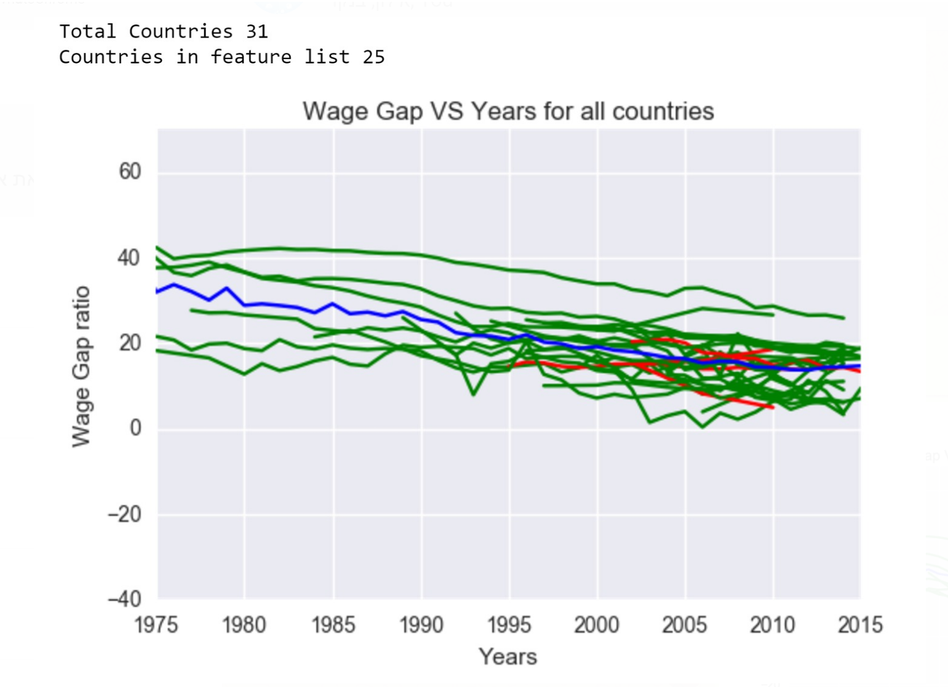
Data Statistics
Wage gap Ratio vs years
Red – countries not in featurs.
Green- countries selected in
features
Blue – average on all countries
Per year.

Slide 13
Correlations

Slide 14
External Articles

Slide 15
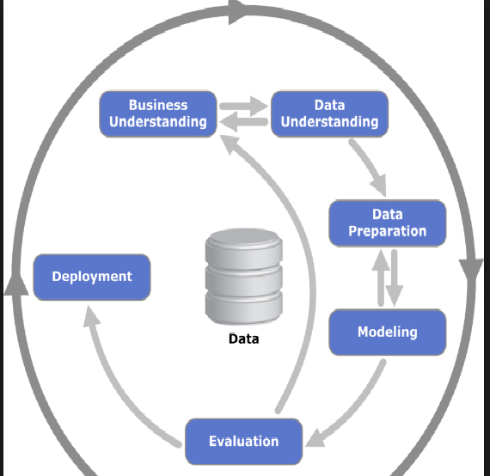
Implementation plan
Millstone | tasks | status
Business understanding | Search salary and gender statistics | Done.
 | Defining the problem | Done.
Data understanding | Focused on GenderStats, Sallary gap csv on OECD | Done.
Data preparation & cleaning | GenderStats - Remove fully empty lines , convert Countries, indicators to columns | Done.
 | Transpose lines to columns - years and country are columns | Done
 | Remove irrelevant columns from both csv’s | Done.
 | Intersect between countries and years | Done
 | Merge oecd data and GenderStats csv | Done
 | complete missing values | Done
Data Analysis | Defining train and test data | Done
 | Select and normalize features (by correlation) | Done

Slide 16
Implementation plan (2)
Millstone | tasks | status
Modeling and Evaluating: | Step 1 - simple linear regression. T-test based feature Removing (manually) | Done
 | Step 2 - L1 regularization for feature selection (lambda by cross validation)
 | Step 3 - data manipulation status - considering cross terms and different missing values system
 | Step 4 -considering usage of Random Forest or SVM
Model Deployment

